Slide 1
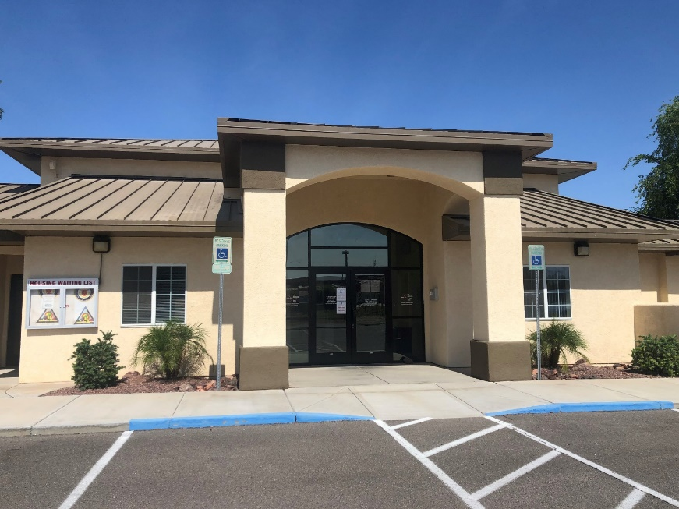
Public Private Venture (PPV) Housing Plain Language Brief (Tenant Welcome & Orientation)
MCAS YUMA Military Housing Office
Marine Corps Installations Command (MCICOM)

Slide 2
Table of Contents
Section | Topics
Welcome & Background | MHO & PPV Partner Contact Information; MHO Services & Responsibilities; PPV Partner Information
Understanding Your Lease | Understanding Your Lease; Pet Restrictions; Tenant Responsibilities
Moving In | What to Expect: Move-In & Move-Out; Pet Deposit; Proof of Renters’ Insurance
Home Maintenance | Maintaining Your Home; Window Safety Tips; Maintenance Issues; Types of Service Calls
Your Rights as a Tenant | Tenant Bill of Rights; Informal & Formal Dispute Resolution Processes; 7-Year Maintenance History Summary
Valued Feedback | SatisFacts surveys after Move-In, prior to Move-Out, & after every Work Order performed
Additional Contact Information | Social Media & Website Links
2

Slide 3
Welcome!
The Military Housing Office (MHO) welcomes you to MCAS Yuma where The Military Housing Office Mission is to provide safe, clean, comfortable and affordable housing for MCAS Yuma personnel and their families as quickly as possible and to enhance their experience in Yuma through a partnership between the Military Housing Office and private sector service providers. We continue forward with programs that boost morale, leading to happy residents and productive service members
This brief is an introduction to your MHO & PPV Partner & includes your rights & responsibilities as a tenant.
Liberty Military Housing is a privatized company that owns & manages your rental property. The MHO, your government point of contact (POC), will assist you with any housing concerns & serve as your housing advocate.
Your PPV Partner now requires you to obtain renters’ insurance as a condition of your occupancy. Renters’ insurance helps protect you & your belongings. Additional information on renters' insurance is found within this brief & is available from your MHO.
3

Slide 4
Contact Information
MHO Contact Information | PPV Partner Contact Information
Street Address: 1093 Thomas Ave | Street Address: 1093 Thomas Ave
Phone: (928) 269-2826 | Phone: (928) 344-1240
Website: mcasyuma.marines.mil | Website: LiveLMH.com
Facebook/Social Media: MCASYuma Instagram: @mcasyuma Twitter: @Yuma_mcas | Facebook/Social Media: https://www.facebook.com/LMHCampPendleton/
Email: Yuma.housing@usmc.mil | Email: yuma@livelmh.com
4

Slide 5
MHO Services & Responsibilities
Installation Commander:
Col. J. K. Stone
Installation Military Housing Director:
Amy Kennedy
The MHO is here to assist you with:
Advocacy on your behalf with the PPV Partner
Applications for service members seeking referrals to live in family housing
Home referral services for off-base housing
Tenant Bill of Rights
Provide assistance during move-in, move-out, pre-inspection & other special inspections performed by PPV Partner
MHO contact for next duty station
Assistance in the dispute resolution process
Housing questions & concerns
5

Slide 6
MHO Personnel
Housing Director:
Amy Kennedy Office: (928) 269-3639 Email: amy.kennedy@usmc.mil
Housing Management Specialist:
Annakaren Reyes Office: (928) 269-3643 Email: annakaren.reyes@usmc.mil
Housing Referral Counselor:
Tara Vanderheyden Office: (928) 269-2826 Email: tara.vanderheyden@usmc.mil
Resident Advocate/Quality Control Inspectors:
Johnny Martin Email: john.martin4@usmc.mil
Maria “Estefani” Kraft Email: maria.kraft@usmc.mil
Ronnie Murrietta Email: Ronnie.murrietta@usmc.mil
Gabriel Argomaniz Email: Gabriel.Argomaniz@usmc.mil
Office hours:
Monday- Friday 0700-1530
AFTER HOUR EMERGENCY COMPLAINTS:
Amy Kennedy Call/Text: (928)941-7527 Email: amy.kennedy@usmc.mil
6

Slide 7
Liberty Military Housing at MCAS Yuma
PPV provides benefits that are not typically offered in community rentals:
Rent cannot exceed the Basic Allowance for Housing (BAH) with dependents rate
No credit history or salary requirements
Basic utilities are included with rent
Resident Energy Conservation Program (RECP) is on hold until further notice
PPV Project
Pool, clubhouse, gym, dog park,
playgrounds
PPV Partner
• Employee-owned company
• Established in 2001, formerly known as Lincoln Military Housing
• 24/7/365 maintenance
7

Slide 8
Understanding Your Lease
Tenants must accept & sign the Universal Lease with PPV’s Addendums. The Universal Lease includes tenant’s rights & responsibilities. The resident handbook is considered part of the lease.
Face-to-face lease signing is available & encouraged, especially if the tenant has questions. DocuSign is the recommended electronic signing option.
Animal Addendum – Identifies pet requirements & breed restrictions (refundable pet deposit of $250 per pet)
Construction & Relocation Addendum – Outlines provisions regarding construction; amenities, community services/facilities, noise & inconvenience, lease termination, lease replacement, release of liability, & damages
Home Based Business Addendum – Identifies requirements for personal business conducted on property
RECP Addendum – Outlines Resident Energy Conservation Program (RECP) process
Other State/Local Addendum – Check other state/local specific requirements
It is important to read through & understand what you are signing. If you have questions about your lease, contact the PPV Partner
8

Slide 9
Tenant Responsibilities
Per your lease, you have several responsibilities to fulfill:
Emergency-1hr | Urgent-4hr | Routine-before end of next business day
9

Slide 10
What to Expect: Move-In & Move-Out
MOVE-IN
MOVE-OUT
The Resident:
Tours the home for quality
Accepts home & terms of lease
Signs a lease
Liberty Military Housing provides:
Walk-through tour of your home
Move-in inspection with checklist
Lease signing & answers to questions
Keys
A survey asking about your move-in experience
MHO provides:
Plain Language Brief & answers to housing policies/questions
MHO representative at move-in inspection per resident request
Follow-up with you (15 & 60 days after move-in)
Support to resolve any unresolved concerns at move-in
Assist with pre-inspections per resident request
The Resident:
Provides a minimum of 30-day notice to vacate to Liberty Military Housing
Returns home in good condition
Liberty Military Housing provides:
Inspection prior to move-out to assess the condition of your home utilizing the move-in inspection checklist
Appropriate maintenance services & speedy issue resolution
Final determination of any damages or repairs & associated costs
Move-out survey for you to provide feedback
MHO provides:
Provides answers to questions & issue resolution process
MHO representative at move-out inspection per resident request
PCS assistance and MHO contact for your next location
Support on any issues
Assist with pre-inspections per resident request Signs Command check-out sheet ON move out inspection
10

Slide 11
Renters’ Insurance Overview
PPV Partner will require you to obtain renters’ insurance. If you are unable to provide documentation, the Partner reserves the right to penalize you through additional charges
Renters’ Insurance is NOT part of the rent you pay to the PPV Partner & does not come out of your BAH
What is renters’ insurance?
Renters’ insurance is a policy which protects your personal property & you from personal lability:
Check what policy covers, terms & conditions vary by provider.
Average renters’ insurance policy costs between $15 to $30 per month.
Widely accessible & may be available through your car insurance company. Ask about discounts & bundling options.
Don’t waive the liability coverage! Typical policies offer $100,000 in liability coverage.
Renters’ insurance will reimburse you for personal property destroyed by a fire. If you accidentally set fire to someone else’s property, the personal liability provision will help reimburse the cost of their damaged belongings
Renters’ insurance typically protects items stolen after a break-in at your rental property, or even items stolen outside of your rental
Damage to your possessions from a burst water pipe is typically covered under renters’ insurance
Personal liability coverage is part of a standard renters’ insurance policy. It may help pay for another person's medical bills if you're found legally responsible for their injuries
For more information on renters’ insurance, ask your MHO for a copy of the Tenant Guide to Renters’ Insurance.
11

Slide 12
Resident Energy Conservation Program (RECP)
RECP is a PPV Housing Program that promotes energy conservation through personal awareness & responsibility. The program was temporarily suspended in February 2020 to address tenant concerns. All services are working with DoD to improve RECP. : Liberty Military has elected to implement RECP at MCAS Yuma
How the Program Works
Each home is metered for utilities. You are to encourage conservation & tenants receive a monthly statement to inform them of their usage.
BAH/rent includes an amount for utilities
Average utilities usage is determined by house type
Tenants that use more receive a bill for the amount over “average” usage, & if they use less they receive a credit for the amount conserved
12
Notes:
The Navy and Marine Corps are issuing new RECP policies that require home meters and wiring to be certified as accurate and define the authorized methods for determining the normal utility usage allocation for PPV tenants

Slide 13
Maintaining Your Home
Please be aware of local guidance & report maintenance issues immediately to your PPV Partner
Promptly clean kitchen counters & dispose of food debris
Keep food in air-tight containers
Clear outside doorways & windows of leaves & dirt
Check your toilets & faucets for leaks
Use exhaust fans in bathrooms & laundry rooms
Report leaks & maintenance issues immediately
Check drains & keep them clear
Replace your filters per directions by your PPV Partner
Clean & monitor major appliances
Check & change batteries for smoke/CO detectors per directions by your PPV Partner
12

Slide 14
Window Safety Tips
Windows are among the top 5 hidden hazards in the home. Before opening a window, know the risks they pose to children
Window Safety Tips
All windows above the first floor should have a Child Fall Hazard warning sticker
Do not rely on screens to prevent a window fall
Only open windows that are out of reach if you need ventilation
Child Safety Tips
Encourage children to play in the center of the room & away from open windows
Pay close attention to furniture, or anything children can climb near open windows
Keep corded blinds as short as possible to keep them out of the hands of small children
PPV Partners & MHOs have installed safety measures to windows with sill heights of 24 inches or lower in homes. Windows with sill heights higher than 24 inches may not have secondary safety devices
13

Slide 15
Maintenance Issues
How to Report Maintenance Issues
Report maintenance issues (maintenance emergencies, trouble calls, safety concerns, compliance issues) right away by contacting your PPV Partner
For an emergency maintenance, call: 888-578-4141
For an urgent maintenance, call: 888-578-4141
For routine maintenance, call: 888-578-4141, or 928-344-1240
Maintenance Number: 888-578-4141
Download the App: Liberty At Your Service App is Available on Apple or Google Play Store
Submitting & Tracking Work Orders
Work Orders can be submitted the following ways:
- Liberty At Your Service App (Resident App)
- Submitting through the District Office
-Liberty At Your Service (Call Center)
The Liberty At Your Service App is available through Apple or Google Play Store.
Through the Liberty At Your Service App you can submit work orders and track their progress with ease.
Contact your PPV Partner if you have concerns on maintenance, work orders, repairs, or services
14

Slide 16
Types of Service Calls
Type of Service Call | Description | Examples | Response Time
Emergency | Critical safety, life threatening issues Resident with a medical requirement for stable temp levels | Gas leaks Fire Power outage Sewage back-up Flood No toilet available for use Refrigerator inoperable | 30-minute initial response 1 day to complete emergency work Available 24/7/365
Urgent | Habitability issues | Broken window Garage door inoperable Kitchen sink back-up Lights flickering or non-working light-fixtures Presence of mold/mildew | 4-hour initial response 1 business day to complete work
Routine | Convenience Unit care issues | Single burner inoperable Repair screens Light bulb replacement | 1 working day initial response 1 business day to complete work
15

Slide 17
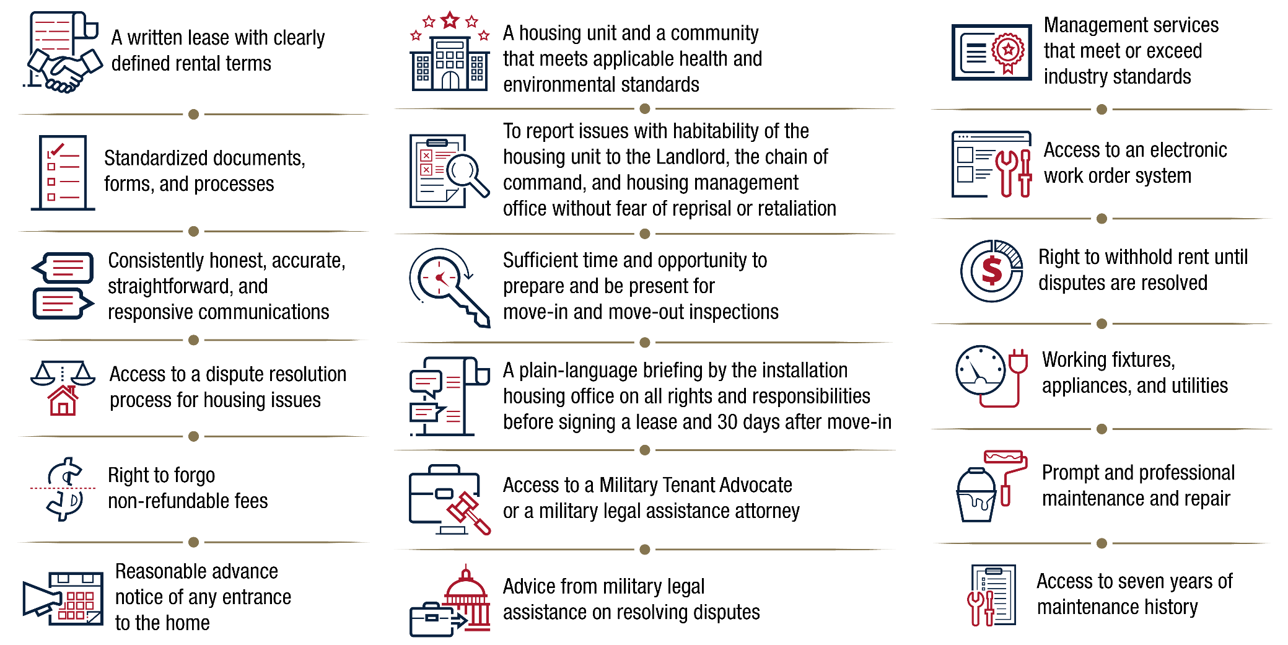
Tenant Bill of Rights
In 2020, laws were passed to assure PPV military residents’ basic rights. MHO will provide residents with a full Tenant Bill of Rights for review
16

Slide 18
Dispute Resolution Process Overview
Active-duty Service Members & their families living in PPV Housing have access to the Dispute Resolution Process (DRP), ensuring prompt & fair resolution for housing issues. Your MHO serves as your advocate throughout the informal & formal DRP
You can initiate the DRP to address lease & property issues such as:
Maintenance & repairs
Rental Payments
Fees & Charges
Displacement Rights
Lease Termination
Inspections
The DRP has two components: an informal & formal process.
Informal DRP
The informal DRP is a process in which you work directly with the PPV Property Manager to resolve your dispute. The PPV PM has the opportunity to address your concerns at all management levels.
Formal DRP
The formal DRP is a standardized, objective process that allows for independent investigation to settle the dispute. The full process takes 30-60 days.
17

Slide 19
Step 1: Informal Dispute Resolution Process
The Dispute Resolution Process starts with an informal process of communication between you & the PPV Property Manager (PPV PM). The informal DRP is the first step you should take to resolve your lease & property concerns
1: If you find a problem at the property where you currently reside, contact your PPV PM so they can take steps to properly resolve the issue. Manuel Padilla (928)344-1240 mpadilla@livelmh.com
2: Elevate to the PPV Regional Manager if the action taken is unsatisfactory. Ivette Polanco (760)400-8179 ipolanco@livelmh.com
3: If the PPV PM or Regional Manager does not resolve the issue, contact the MHO & inform them of the problem at your property. The MHO may investigate the issue. Amy Kennedy (928)269-3639 amy.kennedy@usmc.mil
4: If you are not satisfied that your housing issue has been solved, your MHO will provide you with the Request Form for DRP, initiating the Formal Dispute Resolution Process
18

Slide 20
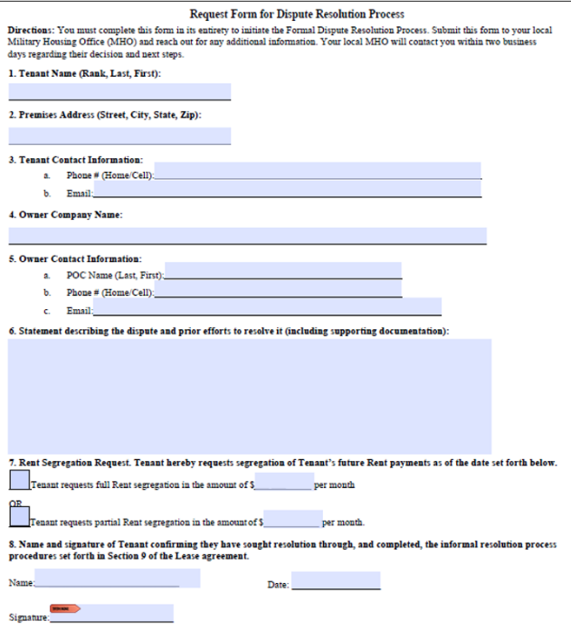
Step 2: Formal Dispute Resolution Process
You must first attempt to resolve your issue through the informal DRP before you can initiate the formal DRP
1. Complete the Request Form
Complete the Request Form & submit it to the MHO, who will validate the form
Completing the Request Form
You can obtain the Request Form from your MHO. You must fill out the form in its entirety. The MHO will determine your eligibility
2. Participate in the Inspection
If your issue is an unresolved property concern, the MHO will schedule an inspection with you & your PPV Partner
3. Cooperate with the Investigation
The Independent Investigator will review all records & conduct interviews as necessary
4. Recommended Action Issued
Send recommendation to Regional Commander. If you disagree with the Commander’s recommendation, submit a rebuttal
5. Final Decision Issued
Regional Commander will consider your rebuttal & provide you a final decision on the dispute
To explore the DRP further, please visit the Marine Corps MHO Website (https://bit.ly/3n2zyGe)
19

Slide 21
Valued Feedback
Your feedback is very important to us. SatisFacts surveys help us identify where we can improve our services & take decisive steps towards better meeting our residents’ needs. It also allows us to recognize our exceptional performers. Additionally, SatisFacts surveys are reviewed by the MHO, Naval Facilities Engineering Systems Command (NAVFAC), & Marine Corps Installations Command (MCICOM).
1. Move-in SatisFacts Survey
You should receive this email survey a couple days after move-in. Assesses if our resident’s expectations are being met from the start.
2. Move-out SatisFacts Survey
Expect this survey shortly after submitting your Notice of Intent to Vacate. Captures our resident’s overall experience living in our communities.
3. Completed Work Order SatisFacts Survey
Received the day after a work order is completed. Assesses efficiency in resolving reported issues.
20

Slide 22
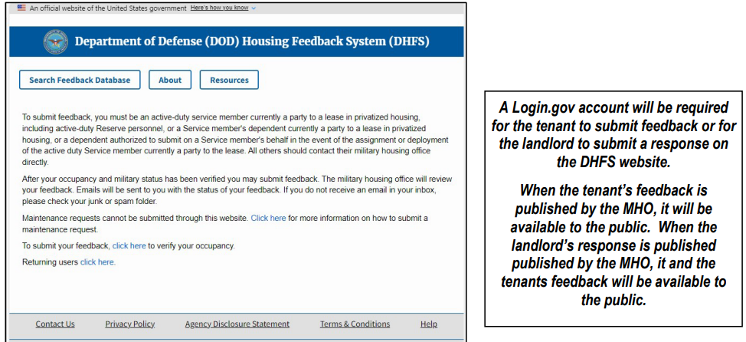
DoD Housing Feedback System
The Department of Defense Housing Feedback System (DHFS) is a public website for active-duty service members currently living in privatized family housing, their dependents, or others authorized to act on their behalf to submit feedback about their current privatized housing unit. https://www.dhfs.mil/rfs/
The DHFS website will collect the tenant’s feedback about the privatized family housing unit & provide that feedback to the landlord. The landlord will be able to review their tenant’s feedback & provide a response.
MHO staff will review the tenant’s feedback & the landlord’s response prior to publication on DHFS. The detailed comments from the tenant & the landlord will be stored in the DHFS database & will be publicly available on the DHFS website.
21

Slide 23
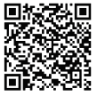
Connect with Marine Corps Housing
http://www.mcas Yuma.marines.mil/
https://www.facebook.com/mcasyuma/
https://mobile.twitter.com/yuma_mcas
https://instagram.com/mcasyuma?utm_medium=copy_link
For information on Marine Corps Housing policies, visit: https://bit.ly/3n2zyGe
22

Slide 24
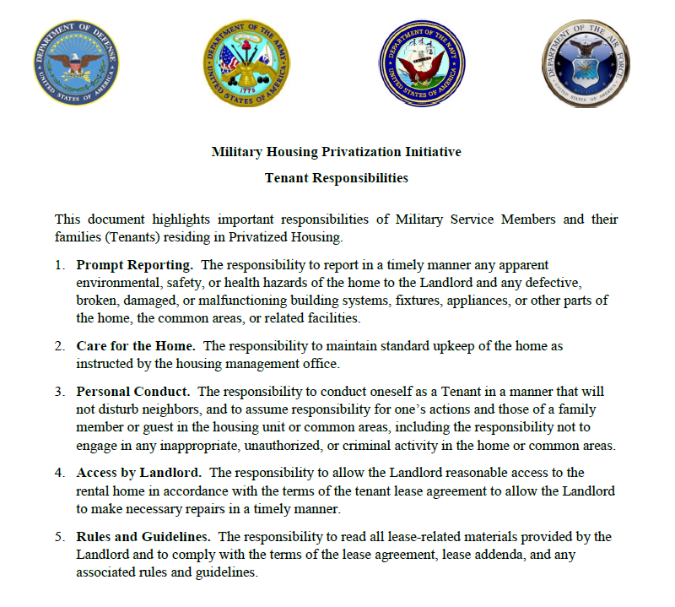

Slide 25
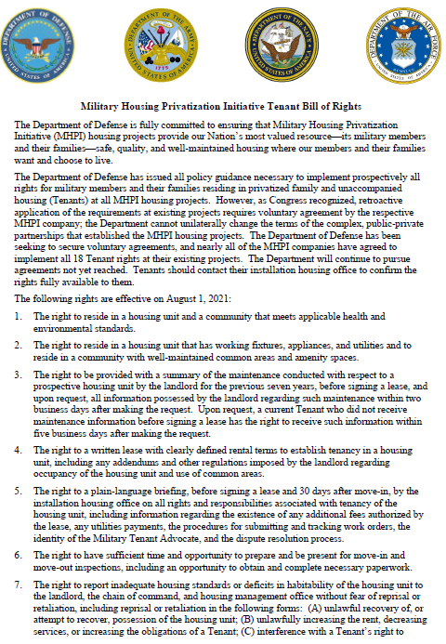
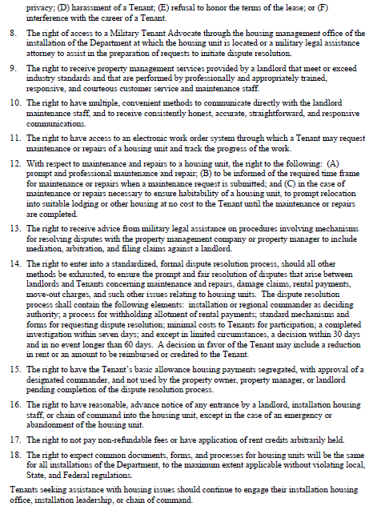

Slide 26
