Slide 1
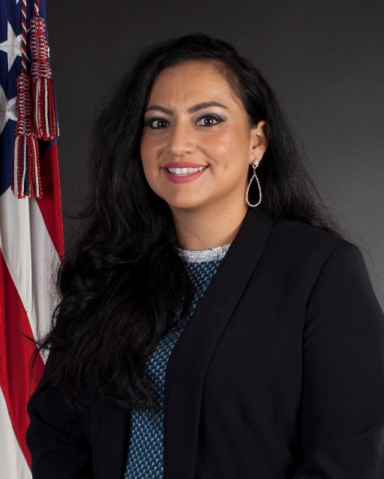
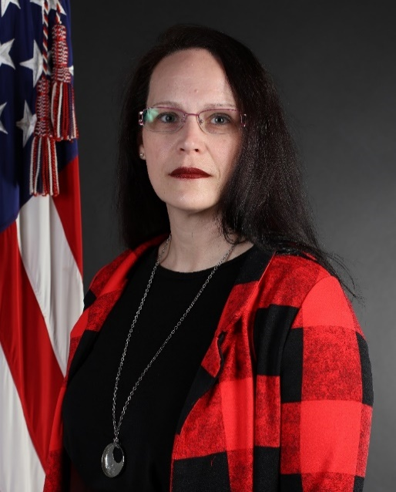
MCAS Yuma
928-941-3601
Sara T. Guerra
Office Phone: 928-269-2994
Office Location Bldg. 598
Jennifer Alderette
Office Phone: 928-269-7895
Office Location Bldg. 598

